Slide 1



CSE 298 – Foundations of Robotics
Lecture 6 - FastSLAM

Slide 2

Sources
Sebastian Thrun, Wolfram Burgard, and Dieter Fox, Probabilistic Robotics, The MIT Press, Cambridge, Massachusetts, 2006.
Michael Montemerlo, FastSLAM: A Factored Solution to the Simultaneous Localization and Mapping Problem With Unknown Data Association, Ph.D. thesis, Carnegie Mellon University, 2003.
Sebastian Thrun’s Homepage: http://robots.stanford.edu/videos.html

Slide 3
Particle SLAM
We want to estimate the posterior pose of the robot along with a map.
Particle filters can represent nonlinear, non-Gaussian processes
Problem: The number of particles needed to represent a posterior grows exponentially with the dimension of the state space!
Compare this with EKF SLAM, which grows cubically

Slide 4
FastSLAM
FastSLAM is a hybrid particle filter/EKF based approach to SLAM.
It solves the dimensionality problem by a factored SLAM posterior
Each particle maintains its own map, wherein each feature is represented by a low-dimensional EKF.

Slide 5
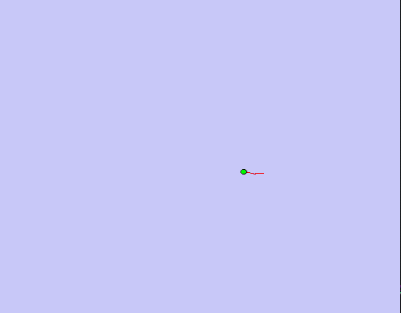
Motivation - Odometry

Slide 6
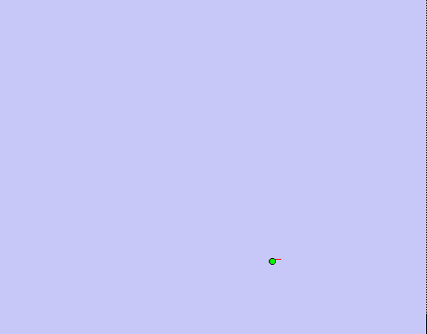
Motivation – Scan Matching

Slide 7
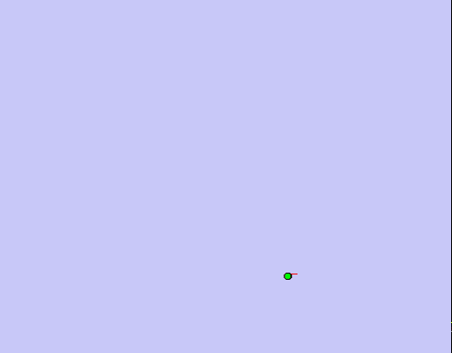
Motivation – FastSLAM

Slide 8

Online SLAM
s_{t-1}
s_{t}
s_{t+1}
u_{t-1}
u_{t}
u_{t+1}
z_{t-1}
z_{t}
z_{t+1}
m
$$p(s_{t},m|z_{1:t},u_{1:t})$$

Slide 9

Full SLAM
s_{t-1}
s_{t}
s_{t+1}
u_{t-1}
u_{t}
u_{t+1}
z_{t-1}
z_{t}
z_{t+1}
m
$$p(s_{1:t},m|z_{1:t},u_{1:t})$$

Slide 10

FastSLAM
s_{t-1}
s_{t}
s_{t+1}
u_{t-1}
u_{t}
u_{t+1}
z_{t-1}
z_{t}
z_{t+1}
m₁
m₂
m₃
$$p(s_{1:t}|z_{1:t},u_{1:t})\prod_{n=1}^{N}{p(m_{n}|s_{1:t},z_{1:t})}$$

Slide 11




Terminology
$$s_{t}=\left[\begin{matrix}x \\ y \\ θ\end{matrix}\right]$$
Robot Pose
Observation
Control
Map Feature
$$z_{t}=\left[\begin{matrix}ρ \\ φ\end{matrix}\right]$$
$$u_{t}=\left[\begin{matrix}v \\ ω\end{matrix}\right]$$
$$m_{t}=\left[\begin{matrix}μ \\ Σ\end{matrix}\right]$$

Slide 12
Algorithm: FastSLAM
On Input: (Y_{t}, u_{t}, z_{t})
Output: Y_{t+1}
Do M times:
Predict – Sample particle from motion model
Observe – Update N landmark EKFs
Weight – Importance weight new particle
Resample – M particles (with replacement) proportional to w^{[k]}

Slide 13





Every Particle is a Hypothesis
$$Y_{t}^{\left[k\right]}=\left\langle s_{1:t}^{\left[k\right]},\left\langle μ_{1,t}^{\left[k\right]},Σ_{1,t}^{\left[k\right]}\right\rangle ,…,\left\langle μ_{N,t}^{\left[k\right]},Σ_{N,t}^{\left[k\right]}\right\rangle ,w^{\left[k\right]}\right\rangle$$
$$s_{1:t}^{\left[k\right]}$$
Path of particle k
$$μ_{1,t}^{\left[k\right]}$$
Expected Pose of landmark1 at time t according to particle k
$$Σ_{1,t}^{\left[k\right]}$$
Uncertainty in pose of landmark1 at time t according to particle k
$$w^{\left[k\right]}$$
Confidence in particle k

Slide 14

Predict
$$s_{t}^{\left[k\right]}\sim p(s_{t}^{\left[k\right]}|s_{t−1}^{\left[k\right]},u_{t})$$

Slide 15

Observe
ρ
φ
$μ_{j,t}^{\left[k\right]}$ $=h^{−1}(z_{t},s_{t}^{\left[k\right]})$

Slide 16
Weight/Resample
.3
.3
.3

Slide 17
Predict

Slide 18
Observe

Slide 19
Observe

Slide 20
Weight/Resample
.2
.7
.1

Slide 21
Predict

Slide 22
Observe

Slide 23
Observe

Slide 24
Weight/Resample
.1
.45
.45

Slide 25
Algorithm: FastSLAM
On Input: (Y_{t}, u_{t}, z_{t})
Output: Y_{t+1}
Do M times:
Predict – Sample particle from motion model
Observe – Update landmark EKFs
Weight – Importance weight new particle
Resample – M particles (with replacement) proportional to w^{[k]}

Slide 26
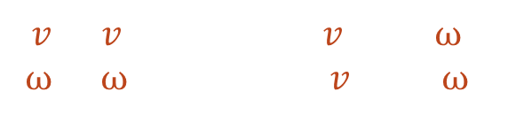

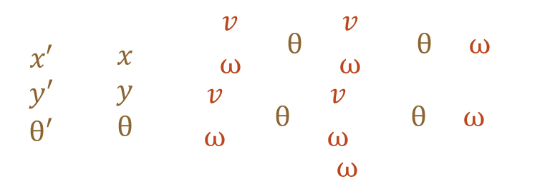
FastSLAM 1.0 - Predict
Sample from motion model
$$s_{t}^{\left[k\right]}\sim p(s_{t}|s_{t−1}^{\left[k\right]},u_{t})$$
Add control noise
$$\hat{v}=v+randn(α_{1}v+ α_{2}ω)$$
$$\hat{ω}=ω+randn(α_{3}v+ α_{4}ω)$$
Propagate motion
$$\left[\begin{matrix}x′ \\ y′ \\ θ′\end{matrix}\right]=\left[\begin{matrix}x \\ y \\ θ\end{matrix}\right]+\left[\begin{matrix}−\frac{\hat{v}}{\hat{ω}}sinθ+\frac{\hat{v}}{\hat{ω}}sin⁡(θ+ωΔt) \\ \frac{\hat{v}}{\hat{ω}}cosθ+\frac{\hat{v}}{\hat{ω}}cos(θ+ωΔt) \\ \hat{ω}Δt\end{matrix}\right]$$

Slide 27




FastSLAM 1.0 – Observe New Feature
Observation Model
$$h(μ_{j},{\hat{s}}_{t})=\left[\begin{matrix}\sqrt{{\left(μ_{j,x}−{\hat{s}}_{t,x}\right)}^{2}+{\left(μ_{j,x}−{\hat{s}}_{t,x}\right)}^{2}} \\ atan2(μ_{j,y}−{\hat{s}}_{t,y},μ_{j,x}−{\hat{s}}_{t,x})\end{matrix}\right]$$
Feature Location
$μ_{j,t}^{\left[k\right]}$ $=h^{−1}(z_{t},s_{t}^{\left[k\right]})$
Jacobian with respect to feature
$$H=∇_{m_{j}}h(s_{t}^{\left[k\right]}, μ_{j,t}^{\left[k\right]})$$
Feature Covariance
$$Σ_{j,t}^{\left[k\right]}=H^{−1}Q_{t}{(H^{−1})}^{T}$$

Slide 28
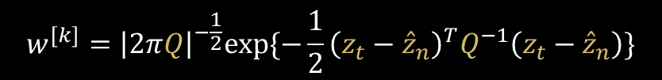






FastSLAM 1.0 – Observe Old Feature
$$\hat{z}=h(μ_{j,t−1}^{\left[k\right]},s_{t}^{\left[k\right]})$$
Predict measurement
$$H=∇_{m_{j}}h(s_{t}^{\left[k\right]}, μ_{j,t−1}^{\left[k\right]})$$
Jacobian w.r.t. feature
$$Q=HΣ_{j,t−1}^{\left[k\right]}H^{T}+Q_{t}$$
Measurement Covariance
$$K=Σ_{j,t−1}^{\left[k\right]}H^{T}Q^{−1}$$
Kalman Gain
$$μ_{j,t}^{\left[k\right]}=μ_{j,t−1}^{\left[k\right]}+K(z_{t}−\hat{z})$$
New feature mean
$Σ_{j,t}^{\left[k\right]}=(I−KH)$ $Σ_{j,t−1}^{\left[k\right]}$
New feature covariance
$$w^{[k]}={\left|2πQ\right|}^{−\frac{1}{2}}exp⁡\{−\frac{1}{2}{\left(z_{t}−{\hat{z}}_{n}\right)}^{T}Q^{−1}\left(z_{t}−{\hat{z}}_{n}\right)\}$$
Feature weight

Slide 29
FastSLAM Complexity
O(M)
Update robot particles based on control u_{t-1}
Incorporate observation z_{t} into Kalman filters
Resample particle set
Constant time per particle
O(M•log(N))
Log time per particle
O(M•log(N))
Log time per particle
M = Number of particles
N = Number of map features
O(M•log(N))
Log time per particle

Slide 30
Data Association Problem

Slide 31
Data Association Problem

Slide 32
Data Association Problem

Slide 33
Per-Particle Data Association
Was the observation
generated by the red
or the blue landmark?
P(observation|red) = 0.3
P(observation|purple) = 0.7
Two options for per-particle data association
Pick the most probable match
Pick an random association weighted by the observation likelihoods
If the probability is too low, generate a new landmark

Slide 34
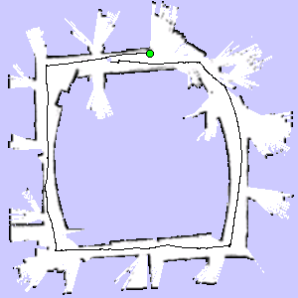
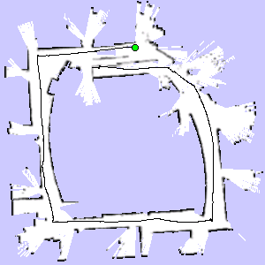
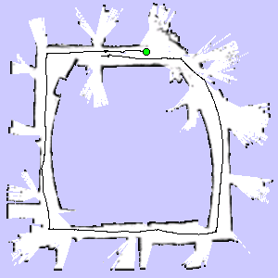
Fast SLAM 2.0
3 Particles
Particle 1
Particle 3
Particle 2

Slide 35
FastSLAM 2.0
Each map is quite big in case of grid maps
Since each particle maintains its own map
Therefore, one needs to keep the number of particles small
Solution: Compute better proposal distributions!
Idea: Improve the pose estimate before applying the particle filter

Slide 36
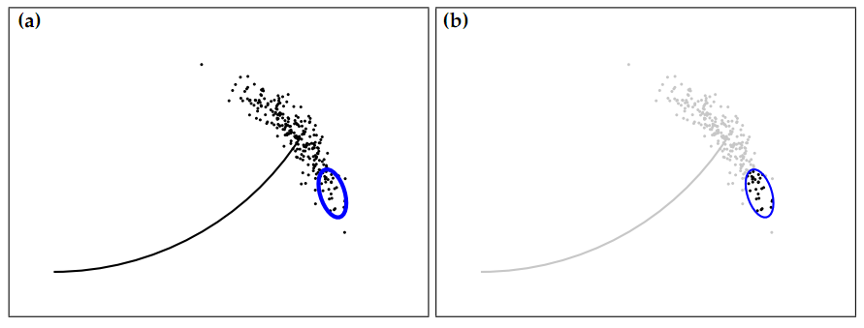

FastSLAM 2.0
Mismatch between proposal and posterior
$$s_{t}^{\left[k\right]} \sim p(s_{t}^{\left[k\right]}|s_{1:t−1}^{\left[k\right]},u_{1:t},z_{1:t})$$

Slide 37

FastSLAM 2.0
s_{t-1}
s_{t}
s_{t+1}
u'_{t-1}
u'_{t}
u'_{t+1}
z_{t-1}
z_{t}
z_{t+1}
m₁
m₂
m₃
$$u_{t−1}^{′}=\left\{\begin{aligned}u_{0:t−1} \\ z_{1:t−1}\end{aligned}\right.$$

Slide 38
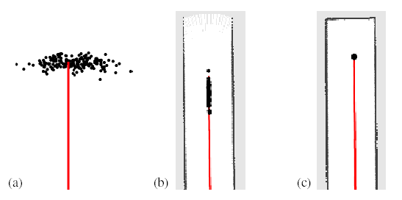
Improved Proposal
The proposal adapts to the structure of the environment

Slide 39
Improved Proposal

Slide 40


Improved Proposal
$$Innovation =\left(z_{t}−{\hat{z}}_{n} \right)$$
$$\hat{z}=h(μ_{j,t−1}^{\left[k\right]},s_{t}^{\left[k\right]})$$

Slide 41
Improved Proposal

Slide 42








FastSLAM 2.0 - Predict
$$s_{j,t}=g(s_{t−1}^{\left[k\right]},u_{t})$$
Predict pose
$$\hat{z}=h(μ_{j,t−1}^{\left[k\right]},s_{t}^{\left[k\right]})$$
Predict observation
$$H_{m}=∇_{m_{j}}h(s_{t}^{\left[k\right]}, μ_{j,t}^{\left[k\right]})$$
Jacobian w.r.t. feature
$$H_{s}=∇_{s_{j}}h(s_{t}^{\left[k\right]}, μ_{j,t}^{\left[k\right]})$$
Jacobian w.r.t. pose
$$Q_{j}=HΣ_{j,t−1}^{\left[k\right]}H^{T}+Q_{t}$$
Measurement Covariance
$$Σ_{s,j}={\left[H_{s,j}^{T}Q_{j}^{−1}H_{s,j}+R_{t}^{−1}\right]}^{−1}$$
Proposal covariance
$$μ_{s,j }=Σ_{s,j}H_{s,j}^{T}Q_{j}^{−1}\left(z_{t}−{\hat{z}}_{j}\right)+{\hat{s}}_{j,t}$$
Proposal mean
$s_{t,j}\sim N(μ_{x,j }$, $Σ_{x,j}$)
Sample pose

Slide 43
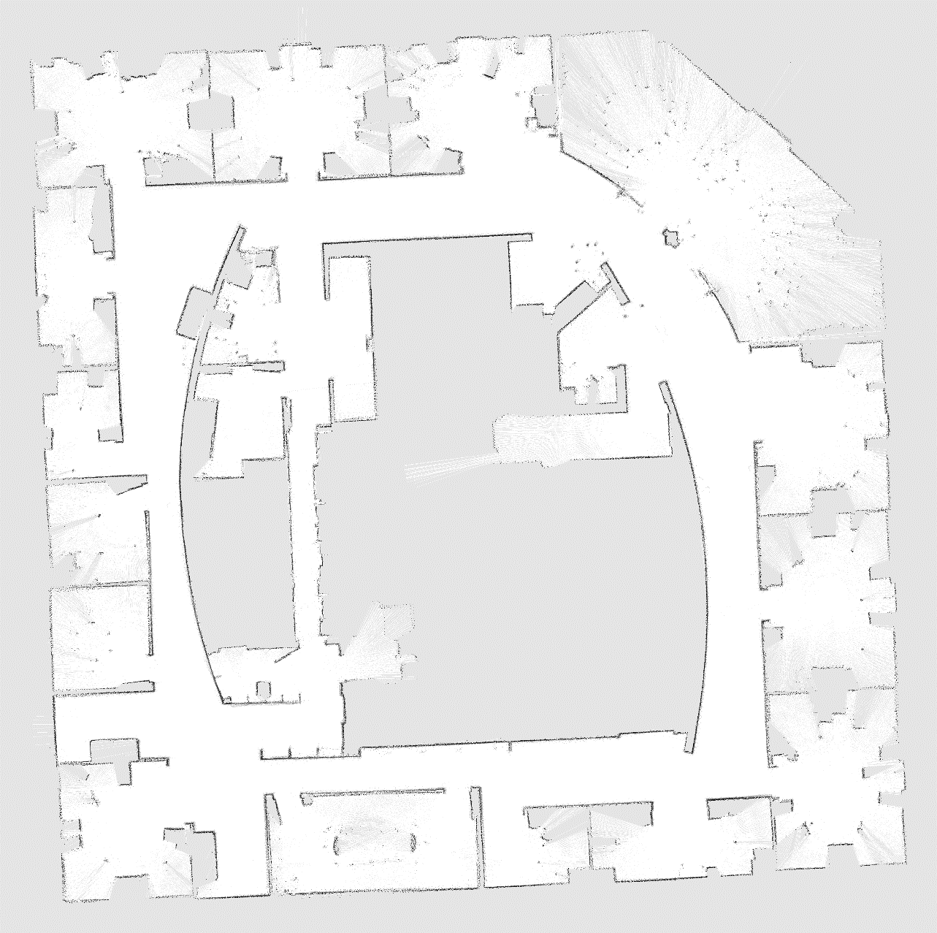
Intel Lab
15 particles
four times faster than real-time P4, 2.8GHz
5cm resolution during scan matching
1cm resolution in final map

Slide 44
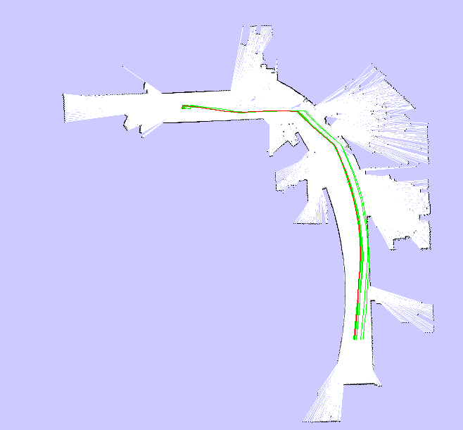
Intel Lab
15 particles
Compared to FastSLAM with Scan-Matching, the particles are propagated closer to the true distribution

Slide 45
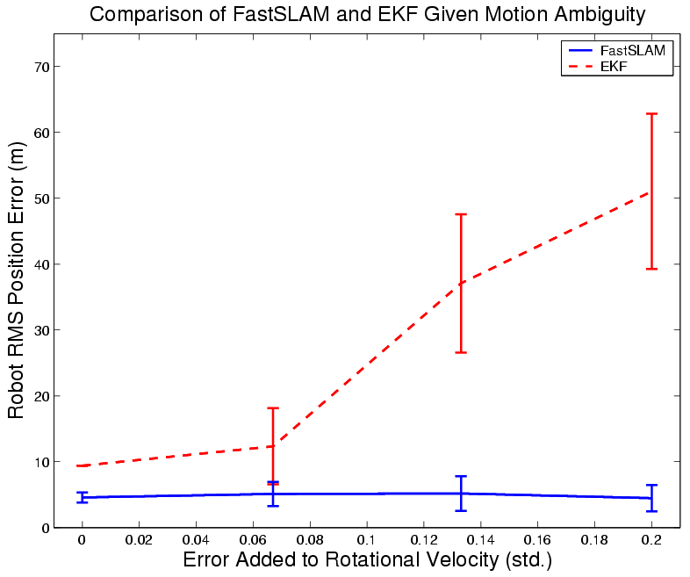
Results – Data Association

Slide 46
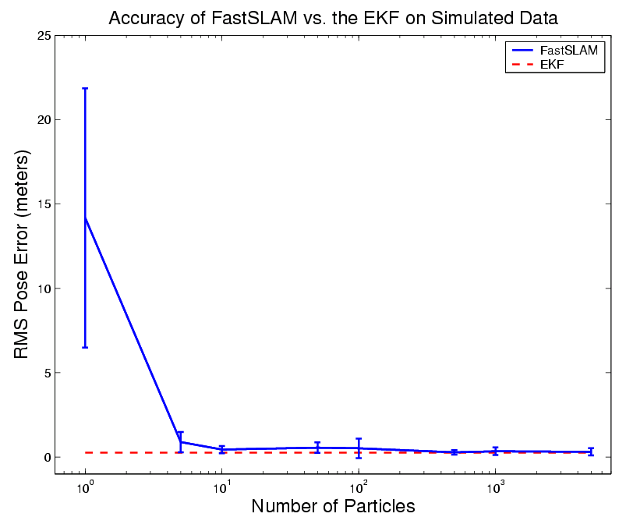
Results – Accuracy

Slide 47

Loop Closure

Slide 48

Multiple Loop Closure

Slide 49
More Details on FastSLAM
M. Montemerlo, S. Thrun, D. Koller, and B. Wegbreit. FastSLAM: A factored solution to simultaneous localization and mapping, AAAI02
D. Haehnel, W. Burgard, D. Fox, and S. Thrun. An efficient FastSLAM algorithm for generating maps of large-scale cyclic environments from raw laser range measurements, IROS03
M. Montemerlo, S. Thrun, D. Koller, B. Wegbreit. FastSLAM 2.0: An Improved particle filtering algorithm for simultaneous localization and mapping that provably converges. IJCAI-2003
G. Grisetti, C. Stachniss, and W. Burgard. Improving grid-based slam with rao-blackwellized particle filters by adaptive proposals and selective resampling, ICRA05
A. Eliazar and R. Parr. DP-SLAM: Fast, robust simultanous localization and mapping without predetermined landmarks, IJCAI03

